Slide 1


Beezr PM - TEAM
/ Market Basket Virtual Student Collaboration Model
Virtual Teamwork
Course Material
Please contact me for any open questions and comments!
08.09.2015 – Ulrik Bisgaard (ub@eaaa.dk)

Slide 2
Virtual Teamwork
A survival competence in the 21st century

Slide 3

What is a virtual team?

Slide 4


Many virtual teams do not function as a team, but rather as a network….

Slide 5

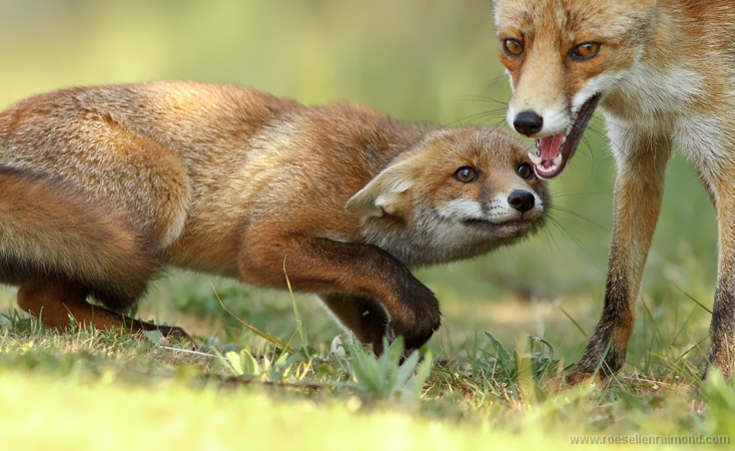
Groupthink

Slide 6
the best employees can be localised all over the world
virtual teamwork provides personal flexibility regarding work time
an organisation with virtual teams can act more flexible to changes in the marketplace

Slide 7

development of ideas can be more innovative, more reflection and less groupthink.

Slide 8
Three levels of teamwork
the team works as a mixture of people: no decisions are made in common
2. conversations take place and decisions are made in common. Products are made that could not be made without the team.

Slide 9
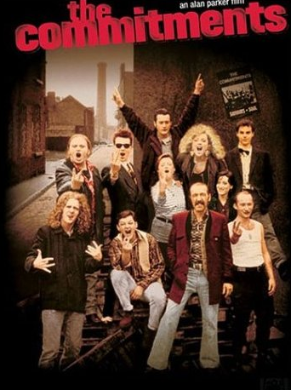

3. team members are strongly committed by the decisions…..

Slide 10
Good teamwork starts with
an initial presentation of you as a person: your interests, your emotional and behavioural characteristics.
a group contract with social codecs regarding accessibility
virtual team building

Slide 11
